Slide 1
Senior Design Proposal P.A.L.M.
Personal Automated Lawn Mower
BRIAN DARLING AND GABRIEL DE LA TORRE
SPRING 2021
HTTPS://PALMMOWER.COM/

Slide 2
Fully Automated Lawn Mower Critical Design Engineering Requirements
The Design of the Personal Automated Lawn mower (P.A.L.M.) shall include the following High Level Requirements:
The user is able to teach the mower which sections of the lawn to mow.
The mower is able to successfully mow a predetermined section of the lawn without further help from the user.
The mower actively charges by using the attached solar panel to extend battery life and is able to return to the docking station once it is done mowing

Slide 3
Fully Automated Lawn Mower Critical Design Engineering Requirements
The Design of the P.A.L.M. shall include the following Mid-Level Requirements:
The mower is able to automatically detect and go around obstacles in its path using the bumper sensors
The mower remembers the mowing path for future use.
The Design of the P.A.L.M. shall include the following Low-Level Requirements
The mower provides at least 45 minutes of mow time on one charge.
The mower is fully recharged while docked.

Slide 4
Fully Automated Lawn Mower Critical Design Engineering Requirements
Requirements and Specifications
The P.A.L.M. provides automatic maintenance of the users lawn with the only contact required being the initial setup of the mower. The engineering specifications table shows the project’s requirements and product specifications. These specifications ensure ease of use for the user as well as an automatically recharging and deploying system to ensure the lawn is constantly being maintained.
Link to Engineering Specifications:
https://palmmower.com/senior-design-proposal/proposal-engineering-specifications/

Slide 5
Fully Automated Lawn Mower Project Budget Table
Description | Qty | Vendor | Price | Extended price | Total Price
raspberry pi 4 | 2 | Amazon | $61.88 | $123.76 | $431.45
car kit | 1 | Amazon | $79.00 | $79.00
solar panels | 2 | Amazon | $25.99 | $51.98
blades | 1 | Amazon | $5.68 | $5.68
battery | 2 | Amazon | $21.99 | $43.98
power converter | 2 | Amazon | $14.99 | $29.98
wire 50 feet | 1 | Amazon | $9.16 | $9.16
humidity sensors | 1 | Amazon | $11.98 | $11.98
wire station |  | TBD |  | $0.00
wire sensor |  | TBD |  | $0.00
Push Button | 2 | Amazon | $7.99 | $15.98
3D Printed Parts | 3 | Jawstec | $10.00 | $30.00
blade motor | 1 | 775 Motor | $29.95 | $29.95
https://palmmower.com/senior-design-proposal/proposed-budget-and-time/

Slide 6
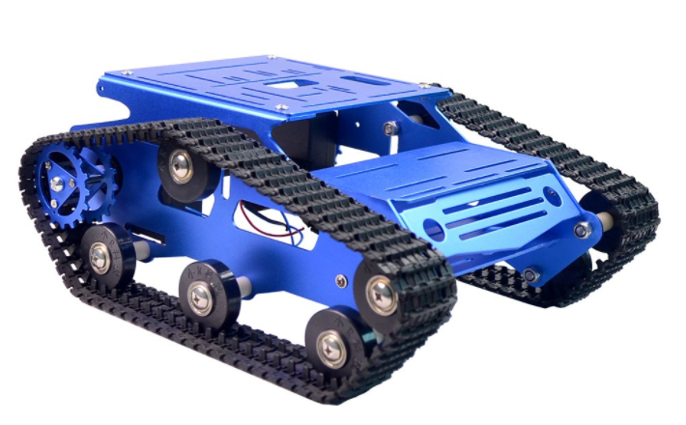
Fully Automated Lawn Mower Components of Note
Aluminum Car Chassis with Tank Treads
Pros:
All terrain capability
Can climb up to 30 degree inclines
metal construction
Plenty of room to add additions
Light weight (2.65 lbs)
Cons:
Unknown drive motors
Only includes chassis, drive motors, and tracks
Can only support up to 15 lbs

Slide 7
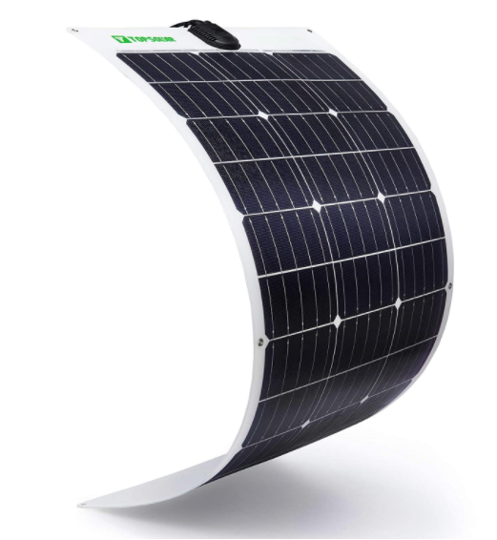
Fully Automated Lawn Mower Components of Note
Flexible 10W 12V Solar Panel and Charge Controller
(Tentative)
Pros:
Light Weight
Low Cost
Can be angled around bends
Lower profile
Cons:
Lower efficiency (12% - 15%)
Less Durable

Slide 8
Fully Automated Lawn Mower Power Budget
Power Budget
Part | Description | Qty | Power (W) | Extended Power (W) | Total Power (W)
Control Module | Raspberry pi 4 | 2 | 15.30 | 30.60 | 161.43
car kit | Robot Smart Car Chassis | 1 | 10.80 | 10.80
blades motor | blades motor | 1 | 120.00 | 120.00
humidity sensors | Gowoops DHT22 Sensor | 1 | 0.01 | 0.01
wire sensor | wire sensor | 1 | 0.01 | 0.01
https://palmmower.com/senior-design-proposal/proposal-power-budget/

Slide 9
Fully Automated Lawn Mower Weekly Schedule For February
Feb 14th - 20th:
Further research best solar panel options and motors
Feb 21st - 27th:
Determine ideal microcontroller options, GPS, Sensors, and controller options
Feb 28th - 6th:
Determine boundary sensor and emitter configurations

Slide 10
Fully Automated Lawn Mower Timeline
Task | January | February | March | April | May | June | July
Research Ideas
Work on website and report
Proposal Presentation
Purchase Components
Coding and building of Mower
Work on Design report and website
Software and Hardware Testing
Design Presentation
https://palmmower.com/senior-design-proposal/proposed-budget-and-time/

