Slide 1
Senior Design Proposal - Automated Lawn Mower - Voice Controlled Wheelchair
Brian Darling and Gabriel De La Torre
Spring 2021
https://darlbc.wixsite.com/bg2021

Slide 2
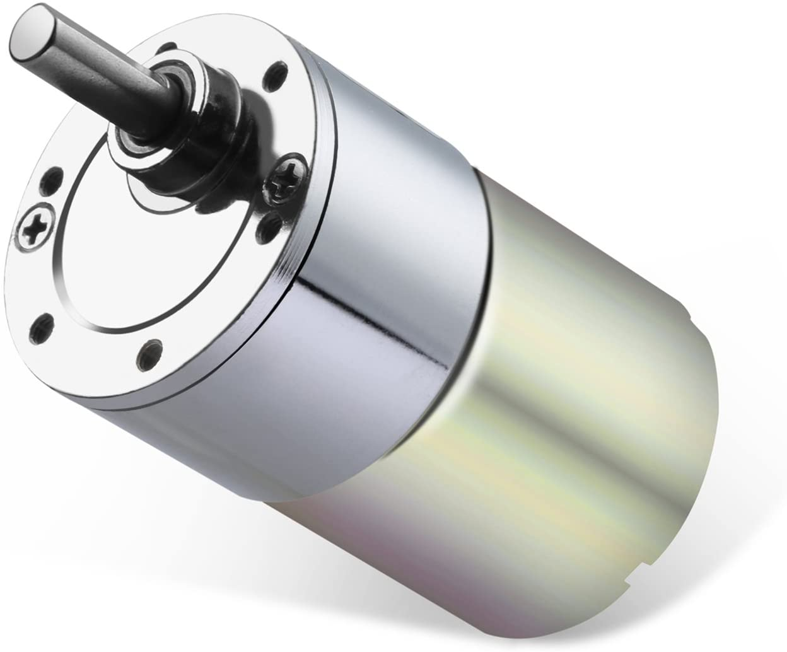
Fully Automated Lawn Mower Team Member Responsibilities
Coding
Gabe will oversee writing code and program interface
Brian will do QC and verify correctness
Electronics
Brian and Gabe will share responsibilities of component procurement
Gabe will take the lead in microcontroller and interface components
Brian will take the lead in robotic movement and physical interface components
Hardware
Brian will oversee structural design and component interface
Gabe will do QC and verify correctness

Slide 3
Fully Automated Lawn Mower Justification and Technical Qualifications
Gabe
Experienced coding Raspberry Pi controllers.
Owns several Raspberry Pi devices and has the software to create code.
Education track is focused on computer systems.
Understands fundamental circuit design and can create systems with Raspberry Pi controllers.
Brian
8 years of on the field mechanical assembly for electronic devices for both prototype and production assemblies.
8 years on the field experience as a Process Writer developing in house manufacturing manuals for an Electronics Manufacturing Services provider building assemblies for a multitude of industries.
Helped build and implement design changes for prototype assemblies for real world devices currently in use.
Experienced with troubleshooting electronic devices (Implemented and operated the repair depot at previous job for Stanley Security Systems).
Experienced with 3D CAD design and having designs 3D printed or CNCed from metal.

Slide 4
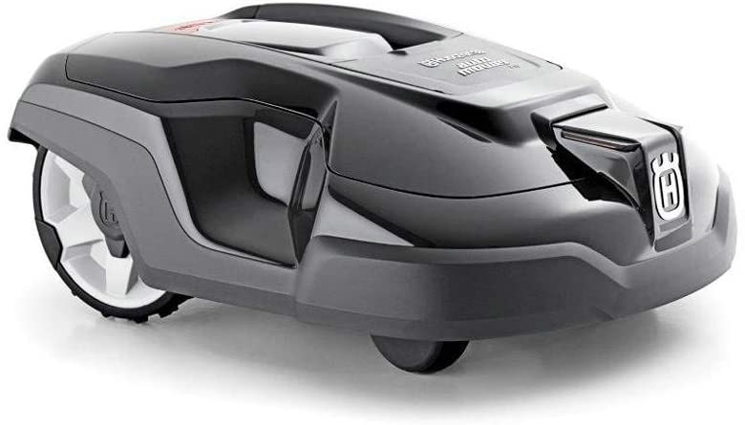
Fully Automated Lawn Mower Similar Existing Products and Services
MowBot
Local lawn service that currently employs Husqvarna robotic lawnmowers
Has anti-theft alarms and GPS locators
Uses underground boundary wires
Husqvarna Mowers
Uses GPS guidance modules
Uses underground boundary wires
Bluetooth communication to Cell Phones
Charging station
MowRo
Uses GPS guidance modules
Uses underground boundary wires
Rain Detection
Charging station

Slide 5
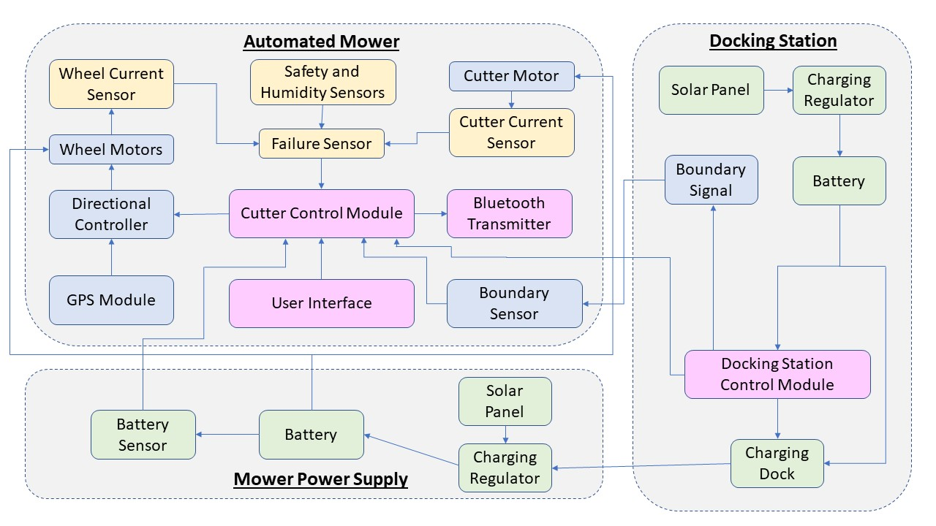
Fully Automated Lawn Mower Modified Block Diagram
Updates:
Simplified Docking Station
Added Solar Panel to Mower
Added Bluetooth Transmitter for phone integration

Slide 6
Fully Automated Lawn Mower Tentative Weekly Design Work Schedule
Fully determine scope of entire project and refine process flow
Determine best controllers based on required input and output requirements
Determine motors, GPS modules, Sensors, Antennas, ect needed to complete each requirement
Determine power supply needed to run unit for at least an hour and charging system
Verify compatibility and estimated battery life of unit
Purchase needed electronics and hardware and double check all components will fit specs
After all components are in hand, design housing to hold hardware. Start building code framework
Continue design and code and order any custom parts
Continue integration, code development, and order any custom parts that may be needed.
Have all movement and guidance systems created and initiate first power and basic controls tested (no test on cutter or sensors)
Refine Code and Controls + start preparing for safety code integration
Introduce safety devices and cutter blade
Live safety test and docking test
Full test in designated areas for grass height comparison.

Slide 7
Fully Automated Lawn Mower Speculated Base Component Costs
Component Name | Price
Raspberri Pi | $75
Distance Sensor HC SR04 (Qty 5) | $20
Breadboard and wiring devices | $35
High Torque Brushless Motor (Qty 4) | $140
GPS and Antenna Comm Modules | $50
Chassis and Hardware (approx) | $80
Solar Recharge Stations | $100
Total | $500+

Slide 8
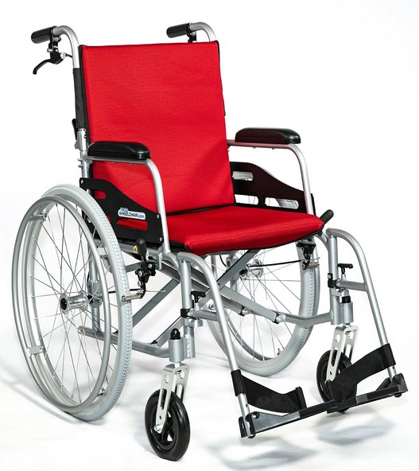
Voice Controlled Wheelchair Team Member Responsibilities
Gabe:
Coding and software related tasks
Procuring microcontroller and interface components
Raspberry Pi interface
QC of hardware related tasks
Brian:
QC of software related tasks
Procuring Hardware and motorized components
Assembly and hardware related tasks
Physical interface of the chair

Slide 9
Voice Controlled Wheelchair Justification and Technical Qualifications
Gabe
Experienced coding Raspberry Pi controllers.
Owns several Raspberry Pi devices and has the software to create code.
Education track is focused on computer systems.
Understands fundamental circuit design and can create systems with Raspberry Pi controllers.
Brian
8 years of on the field mechanical assembly for electronic devices for both prototype and production assemblies.
8 years on the field experience as a Process Writer developing in house manufacturing manuals for an Electronics Manufacturing Services provider building assemblies for a multitude of industries.
Helped build and implement design changes for prototype assemblies for real world devices currently in use.
Experienced with troubleshooting electronic devices (Implemented and operated the repair depot at previous job for Stanley Security Systems).
Experienced with 3D CAD design and having designs 3D printed or CNCed from metal.

Slide 10
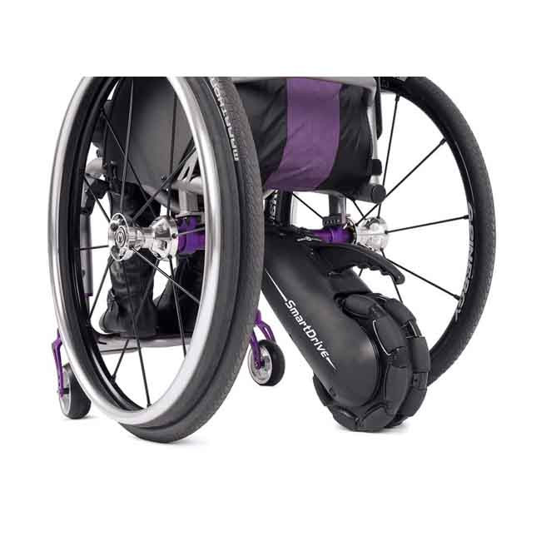
Voice Controlled Wheelchair Similar Existing Products and Services
VoiceDriver by AutoNOMOS Labs
Electric Wheelchair
Controlled using a Laptop and Microphone
SmartDrive MX2
Attaches to back of wheelchair
Adds an additional push assist for momentum
Wristband Control
Smart Watch Voice Command Car
Toy car with smart watch integration
Uses voice commands to move

Slide 11
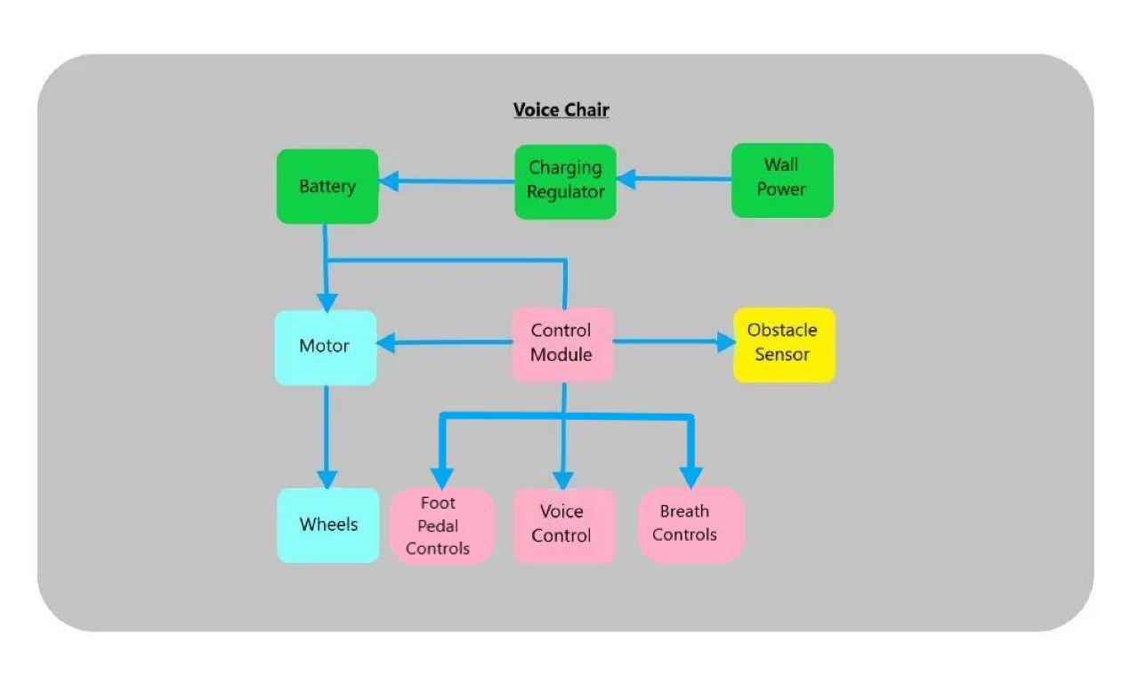
Voice Controlled Wheelchair Modified Block Diagram
Updates:
Added backup foot pedal controls
Added backup breath controls

Slide 12
Voice Controlled Wheelchair Tentative Weekly Design Work Schedule
Determine viability of the project and general complexity
Determine if Raspberry Pi will have enough ports or which controller would be a better option
Determine motor, distance sensors, microphone, wheels, and chair
Determine power supply required to power the system and move the necessary amount of weight.
Purchase and check the compatibility of the hardware
Begin assembling hardware components
Continue writing code and testing compatibility with components
Begin testing the multiple expected outcomes of the system
Once, voice recognition is successful, begin tweaking movement speed and turning rate.
Refine Code and begin adding extra safety features
Run multiple tests for obstacle detection using the distance sensor
Run multiple tests using the voice command for maneuvering around obstacles
Final test using both voice command and auto safety features in a real world scenario

Slide 13
Voice Controlled Wheelchair Speculated Base Component Costs
Component Name | Price
Raspberri Pi | $75
Distance Sensor HC SR04 (Qty 5) | $4
Breadboard and wiring devices | $37
Smart Robot Car Kit | $159
Throat Microphone | $36
Total | $311+

