Slide 1
Senior Design Proposal
Project Ideas
Brian Darling and Gabriel De La Torre
Spring 2021
https://darlbc.wixsite.com/bg2021

Slide 2
Automated Pet Feeder With RFID
Some people who have multiple pets may have one or more of their cats or dogs either gorging themselves on all the food you put out for them at once or eating other pets food. Having a system that portions out the food periodically throughout the day and only allows one pet to eat from the bowl is a very helpful way to make sure all of your pets get their fair share of food.
This pet food feeder will allow the owner to set how much food the designated pet will be allotted per day and how many times per day the food will dispense. With the addition of either an active or passive an RFID tag that the pet will wear on their collar, this will either lock the pet out of the food dish or open the food dish to allow the pet to eat.
Adding in a battery backup system will keep the feeder active in the event of a power failure so that the pets will have a continuous source of food if you are not available to manually feed them.

Slide 3
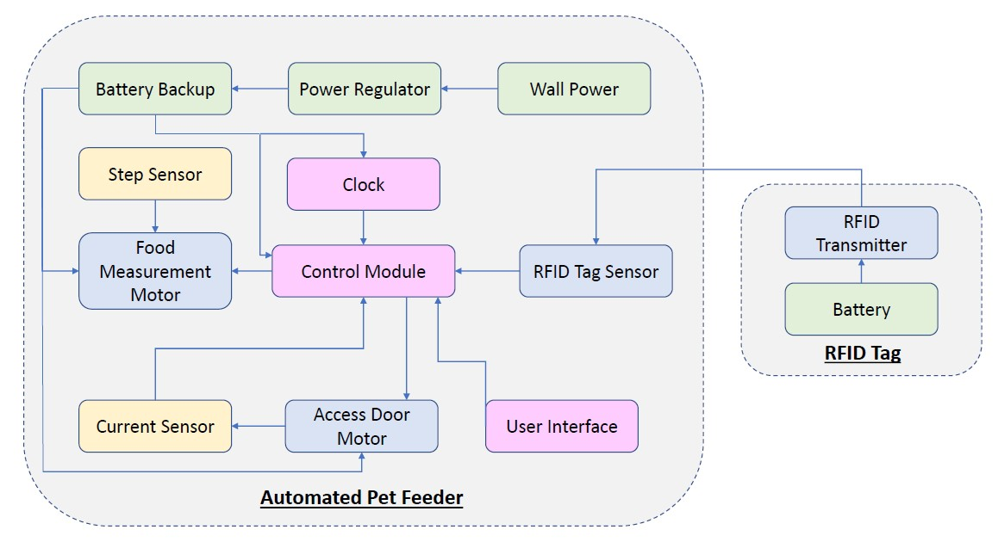
Automated Pet Feeder With RFID

Slide 4
Automated Pet Feeder With RFID
Research Timeline
1) Determine Controller and power source
2) Determine best method for measurement and RFID technology (passive or active)
3) Spec secondary motors and design housing configurations
4) develop code for UI and scheduling
5) Live test
Estimated Costs
Electronics = $200
Hardware = $250

Slide 5
Fully Automated Lawn Mower
Lawn maintenance can be time consuming and exhausting, especially for a highly active family. Not to mention the hot summer heat can be brutal on the elderly and those with health conditions.
A fully automated lawn mower that can maintain the yard several times a week can really help time restricted families make more time for other things they need to do, reduce weeds growing in the yard, and save households money over time from lawn maintenance services.
​This mower will be a fully automated system that will cut the grass on autopilot with the users preferred cutting consistency. To easily and efficiently control the cutting area, there will be an underground wire emitting a signal. This will create an "invisible fence" to help the mower stay within its cutting boundaries.
​Adding in safety features like obstruction detection, mower flip sensors, and ways to check if the blade and wheels are stuck will prevent any injuries and help prolong equipment life.
​With the addition of solar panels and rechargeable batteries, the mower can also reduce the households carbon footprint and noise output. The mower will self dock at a charging station or have solar panels on the unit itself and be self charging.

Slide 6
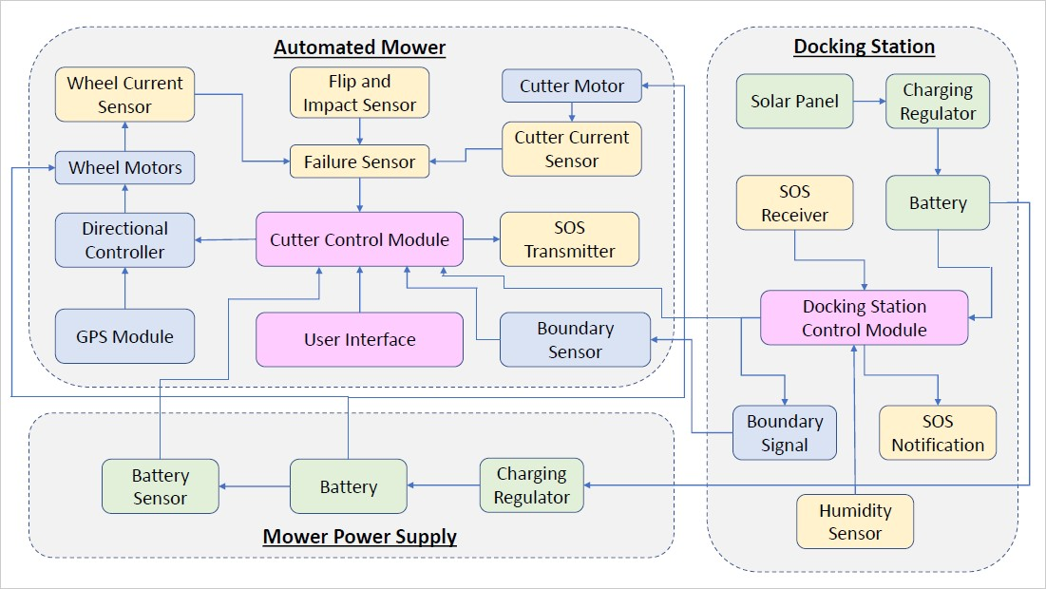
Fully Automated Lawn Mower

Slide 7
Fully Automated Lawn Mower
Research Timeline
1) Determine structure and electronic controllers
2) Determine best wheel and cutter mowers
3) Create keep out fence and code for movement path
4) Integrate obstruction sensors and humid sensor
5) Create timer patterns and test
Estimated Costs
Total = $800

Slide 8
Voice Controlled Wheelchair
Wheelchairs are a very common form of transportation for people with special needs. Some even have battery powered motors to help people easily get around. These electric wheelchairs are normally controlled by a joystick on the armrest. But what if someone doesn't have the use of their arms or legs? The V chair is a voice controlled wheelchair that can easily be steered without having to rely on any of your limbs.
The V chair would come with a wearable microphone which the user would speak into to control the chair. Simple, one syllable commands would all that they need to control the wheelchair. "Go" would be used to move forward, "left" and "right" to turn, and "stop" to cease movement.
The advantage of the V chair is that it would give users a level of mobility and independence that they didn't have before. They wouldn't have to rely on anyone to steer or push the wheelchair for them and it would be simple to control.

Slide 9
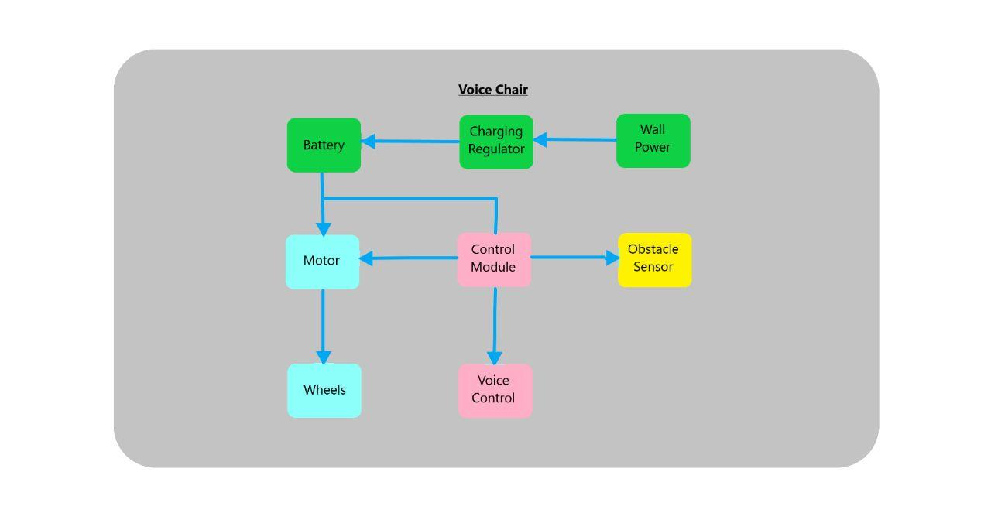
Voice Controlled Wheelchair

Slide 10
Voice Controlled Wheelchair
Research Timeline
1) Develop controller module and voice input devices
2) Integrate battery supply and motor controls on platform
3) Integrate obstacle sensors and charging system
4) Full systems Test
Estimated Costs
Electronics = $200
Hardware = $350

Slide 11
Portable Security System
Everyone wants to feel safe and secure. Home alarm systems are a great way to protect you and your family from potential intruders. The only problem is that those systems can only help you when you're staying at your home. What about those times when you're on vacation at a hotel, when you stay at a friend's house, or at a motel. If only there was some way to take that alarm system with you everywhere you went. That is the purpose of the portable security system.
This device will be a portable system that contains all the essential components of a home security system. These components include a motion sensor for detecting intruders, a camera, and an alarm to notify you when an intruder has been detected.
The device itself will have a screen where the user can control all the aspects of the system. The system will also have different modes depending on how the user wants to use it. These modes include a silent mode where the system will detect and record an intruder without
sounding the alarm, an alarm only mode for the system will sound the alarm if it detects an intruder but will not record, or a full alarm mode where the system will both record intruders and sound the alarm.

Slide 12
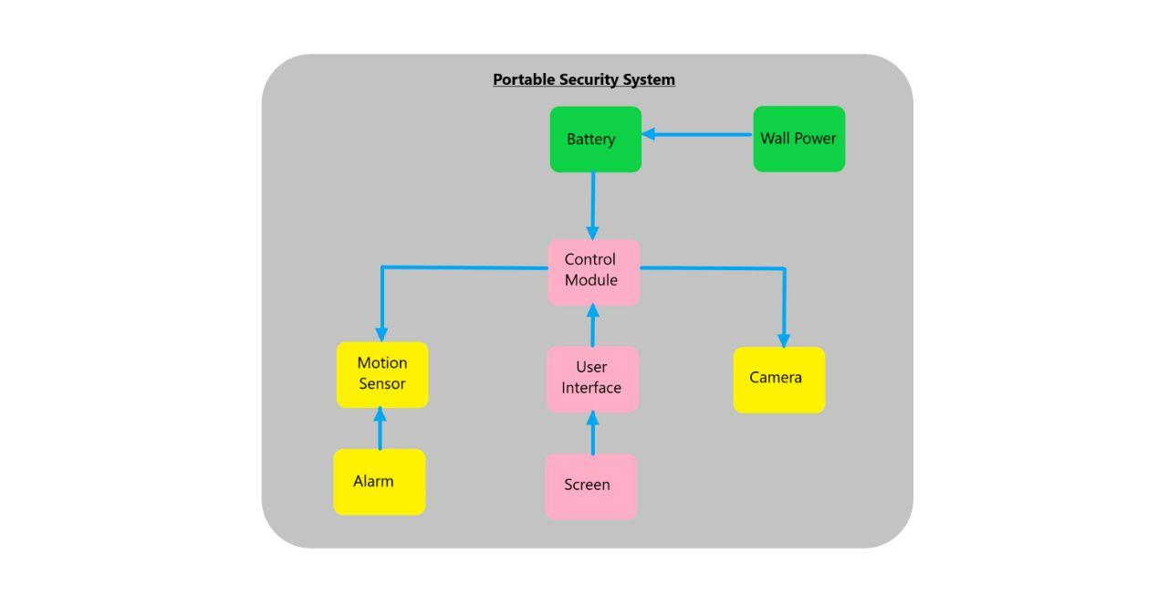
Portable Security System

Slide 13
Portable Security System
Research Timeline
1) Develop controller system and accompanying wireless modules
2) Integrate all systems together and confirm active communication
3) Integrate wireless camera for live video feed
4) configure user interface for password protection and security
Estimated Costs
Electronics = $350
Hardware = $100

