Slide 1
Senior Design Proposal P.A.L.M.
Personal Automated Lawn Mower
GPS, Machine Learning, and Controller
BRIAN DARLING AND GABRIEL DE LA TORRE
SPRING 2021
HTTPS://PALMMOWER.COM/

Slide 2
GPS Controlled System
Standalone System
Pros:
Affordable
Less Power
Less Complex
Cons:
Accuracy between 3m and 1m
Not ideal for guiding a specific path
Image from https://www.kickstarter.com/projects/simplertk2b/simplertk2b-the-first-multiband-rtk-shield-based-o

Slide 3
GPS Controlled System
RTK Base Station with GPS
Pros:
Accuracy between 3cm and 1cm
Allows for accurate pathing
Max range of 20km (dependent on model)
Cons:
More expensive
More complex
Requires a base station with power source (docking station)
Image from https://www.kickstarter.com/projects/simplertk2b/simplertk2b-the-first-multiband-rtk-shield-based-o

Slide 4
GPS Controlled System
Standalone with RTK/SSR corrections
Pros:
Accuracy between 3cm and 1cm (with 3G module)
Allows for accurate pathing
Available wherever there are cellphone towers
Cons:
More complex
Needs a GNSS application board in addition to the RTK/SSS corrections.
Requires 3rd party service availability.
Image from https://www.kickstarter.com/projects/simplertk2b/simplertk2b-the-first-multiband-rtk-shield-based-o

Slide 5
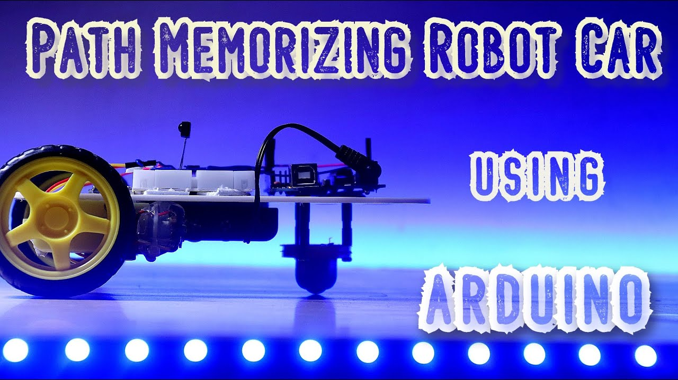
Mower Pathing Options in Consideration
Manual Steering
Pros:
Simple design
Allows for complete user customization
Cons:
Requires user to program
Accuracy of mower can be easily diminished by outside factors
Image from https://www.etechnophiles.com/how-to-make-a-path-memorizing-robot-using-arduino/

Slide 6
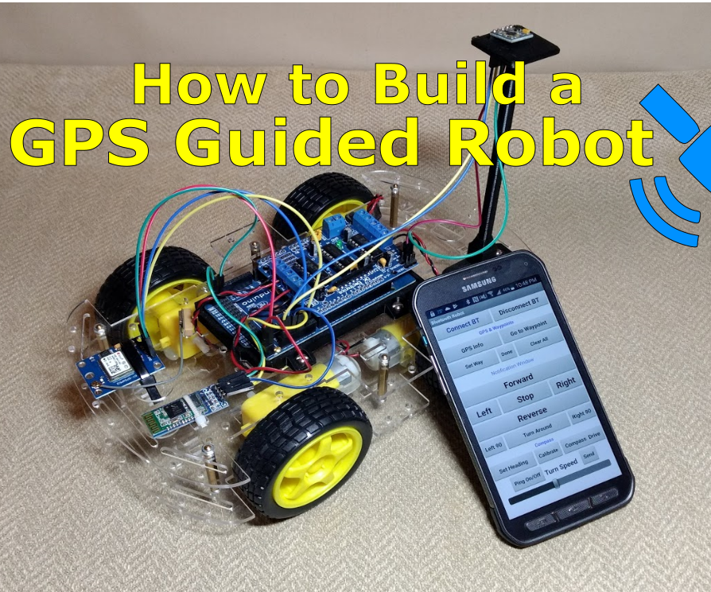
Mower Pathing Options in Consideration
GPS Steering
Pros:
Maintains Accuracy using GPS coordinates
Allows for complete user customization
More autonomous
Accuracy not impacted by outside factors
Cons:
Expensive
Requires a secondary transmitter for accuracy
Image from https://www.instructables.com/How-to-Build-a-GPS-Guided-Robot/

Slide 7
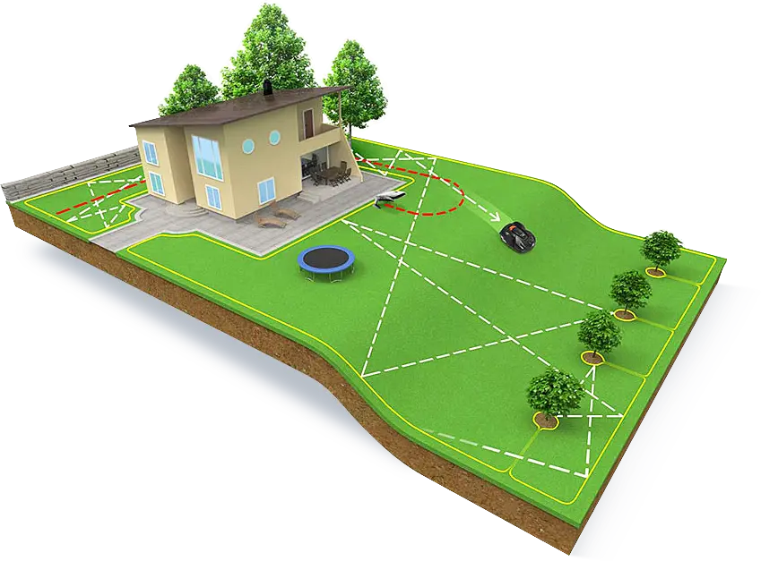
Mower Pathing Options in Consideration
Randomized Direction
Pros:
Very Simple Design
No user input needed
Avoids obstacles
Could be used for machine learning
Supposably healthier for the grass to cut in non uniform paths
Cons:
Very inefficient
Requires a boundary wire for perimeter (if GPS is not equipped).
Can take significantly longer to cut
Image from https://www.gizmow.com/how-it-works/

Slide 8
Machine Learning
Initial Research
Machine Learning uses computer based algorithms and rules to improve a result based upon prior experiences and data collected.
There are plenty of AI libraries available from major companies like Google (TensorFlow) that provide the foundation of self automation for robots.
The primary limitations we may run across for the project is the limited amount of memory and physical limitations of the Raspberry Pi 4.
Image from https://www.forbes.com/sites/tomtaulli/2019/03/02/what-you-need-to-know-about-machine-learning/?sh=37d3ad622fe4

Slide 9
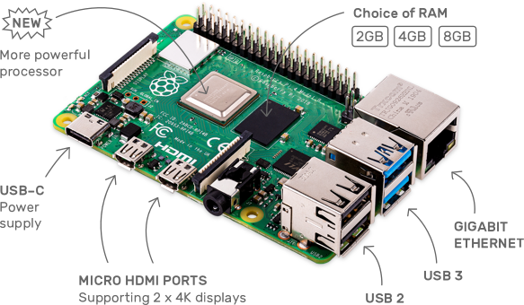
Machine Learning
Design and Program Options
Ways to implement Machine Learning on the Raspberry Pi 4
TesnorFlow Lite
Designed for mobile devices and can work on Raspberry Pi
Has several libraries available to build from
USB Stick
Allows for extra memory and computing space
Easily plugs into the Raspberry Pi USB port
Image from https://www.raspberrypi.org/products/raspberry-pi-4-model-b/

Slide 10
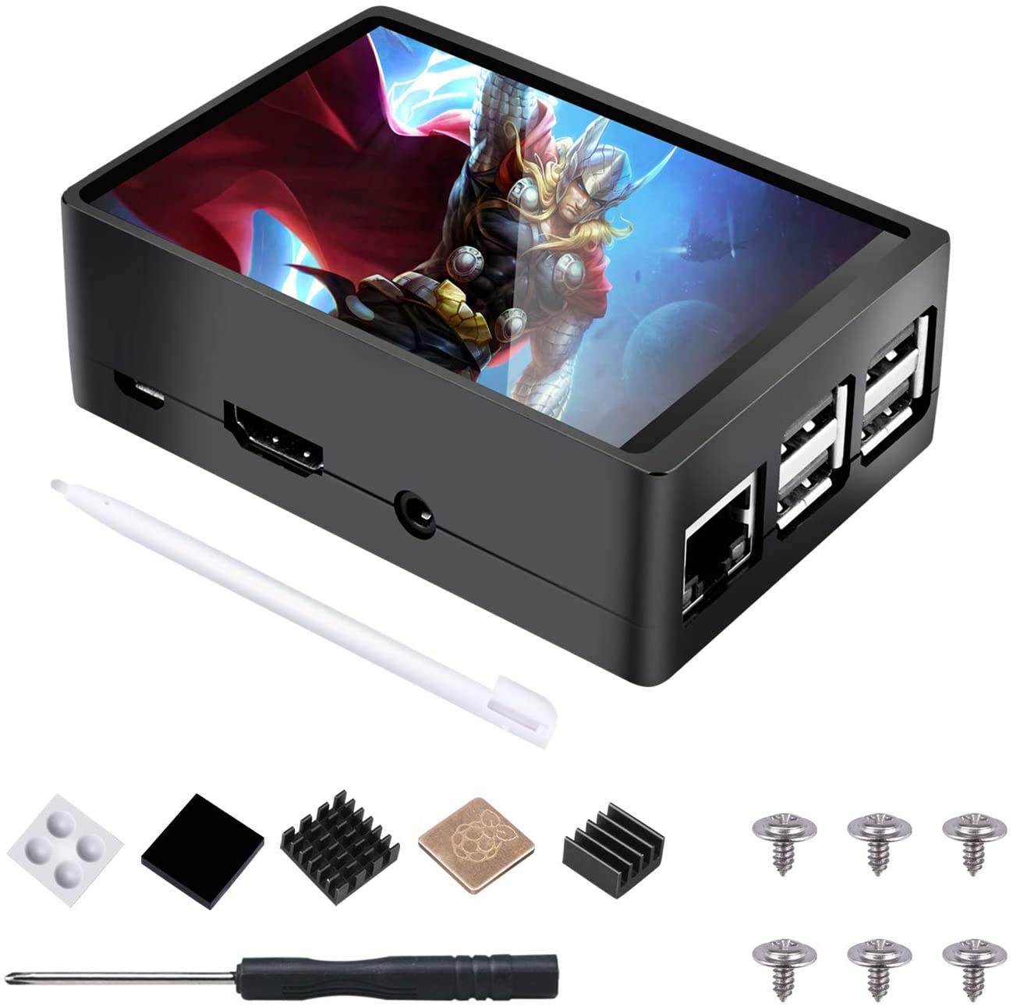
Backup Controller
Preliminary Configuration
If the user does not have a cell phone to directly connect to the mower, they can use a backup controller option using a Raspberry Pi and a touch screen.
There are affordable 3.5” screen kits available for purchase that will work perfectly for this application and are affordably priced.
Image from https://www.amazon.com/STARTO-Raspberry-320%C3%97480-Resolution-Display/dp/B07S695VQM

Slide 11
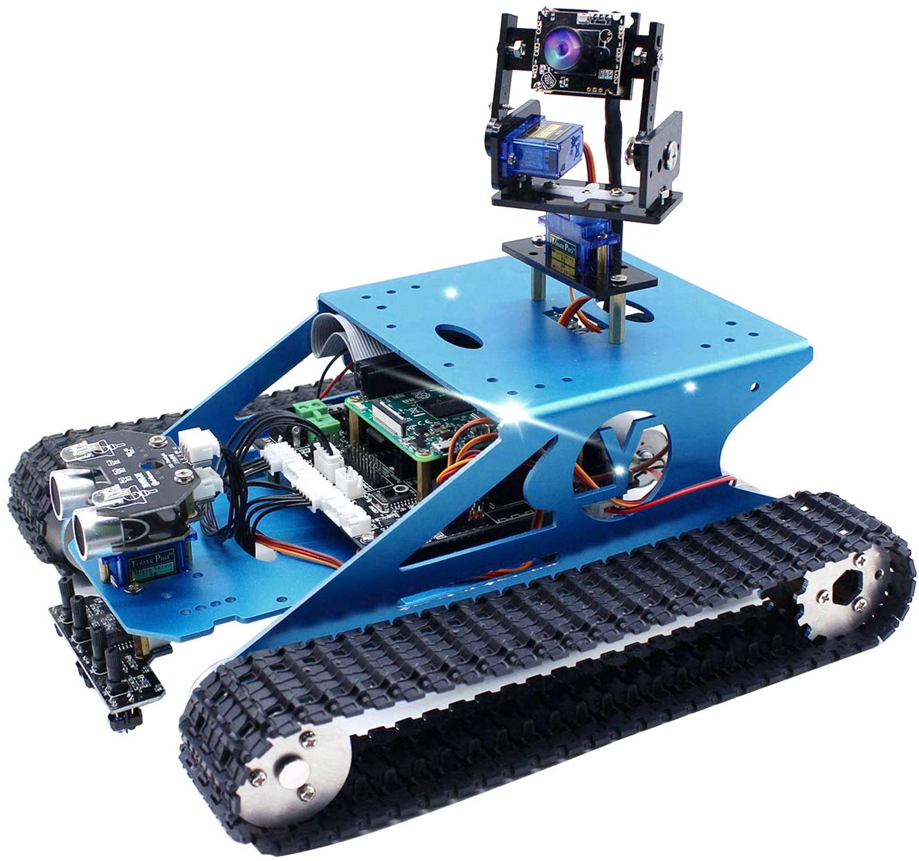
Test Robot (Proposed)
Machine Test Bed
Due to COVID restrictions, frequently meeting up and working together will be a challenge.
Instead of moving one robot back and forth for mechanical and software testing and assembly, we are proposing to have a smaller robot with similar drive functionality to begin preliminary coding and testing on drive functions.
Once we have ensured proper drive functions and programming, we will transfer the code digitally to upload to the PALM.
Image from https://www.amazon.com/Yahboom-Professional-Programming-Electronic-Compatible/dp/B07KRVBGQM

